Slide 1
Intuilize – Cluster Commanders Customer Segmentation & Prediction Weekly Meeting 2/21/2025
Andy, Graham, Keertana, & Shashank

Slide 2
Agenda
Feature Selection
ML Model Analysis
Outliers
Next Steps

Slide 3
Product Mix
Total Sales Quantity
Total Orders
Profit Margin : Ratio of Profit to Sales amount per product
Average Order Size : Ratio of total sales quantity to number of orders
Repeat Purchase Ratio : Ratio of total orders to number of unique customers that buy the product
Used In Customer metrics as : -
High Profit Product Share
Popular Product Share
High Profit Order Ratio
Popular Order Ratio

Slide 4
Features Selected
Total Profit
Total Unit Price
Total Sales Quantity
Order Count
Number of Distinct Products
Number of Distinct Product Groups
Branch Count
Customer Lifetime in Days
High Profit Order Ratio
Popular Order Ratio
Repeat Purchase Ratio

Slide 5
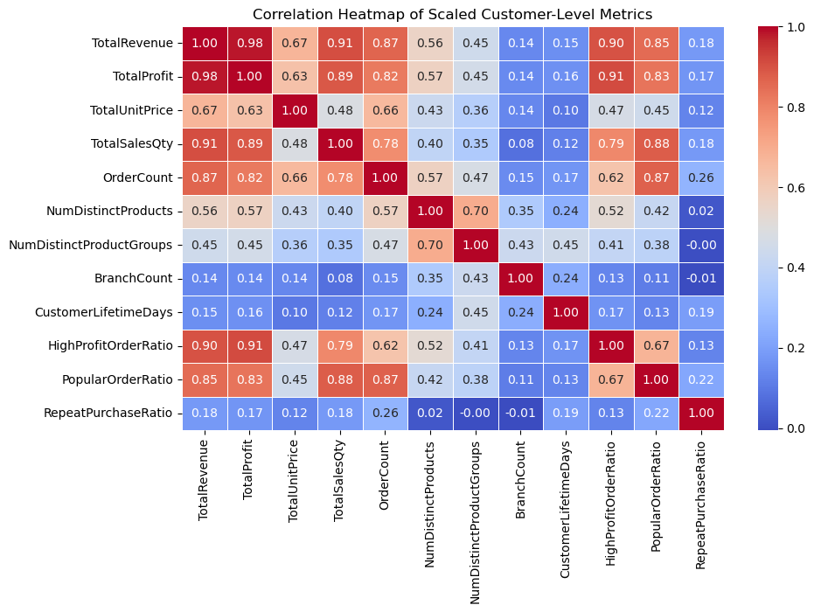
Correlation of selected features

Slide 6
Outliers
TOP :
Roberts LLC Group
Burke and Sons and Sons
Least :
Velasquez Inc

Slide 7
Model Analysis
Fuzzy-C means
Silhouette Score of .90
Testing with multiple features

Slide 8
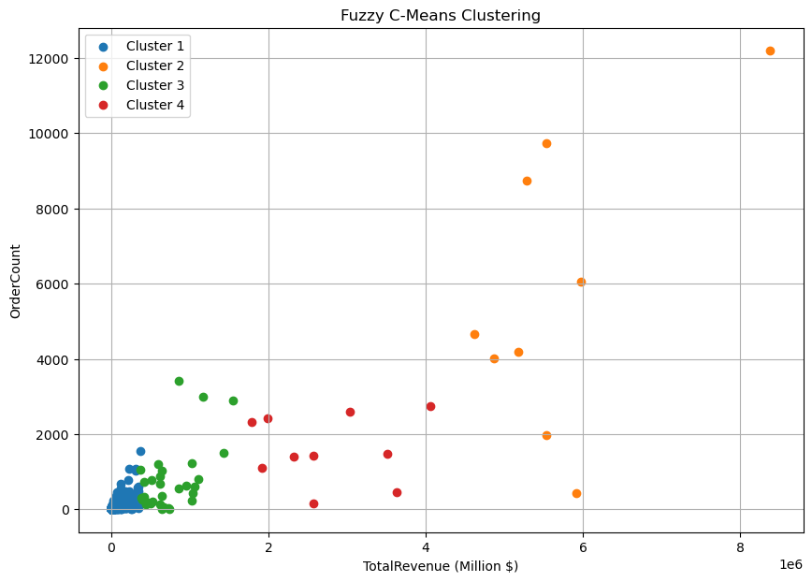
Cluster

Slide 9
Next Steps
Confirm features for ML model
Implement and Test ML model
Begin working on data modeling and design document

Slide 10
THANK YOU!

